Slide 1

Implementation2 CICD Pipeline for Python Application
- By Shubham Sharma

Slide 2
Outline
Overview
Why CICD
Pre-requisites
Project Architecture
Project Code

Slide 3
Introduction
Comprehensive end-to-end configuration and setup of a Continuous Integration (CI) and Continuous Deployment (CD) pipeline.
Sample application which consists of two components: a Python frontend and a Redis cache serving as the database.
Tech Stack: Utilizing Azure DevOps, Terraform, Ansible, Docker, ACR, and AKS
The CI/CD pipeline includes code quality checks, image/package builds, JFROG integration, testing, and deployment to Azure Kubernetes Service (AKS).
Automated deployment to Azure Kubernetes Service (AKS)

Slide 4
Why CICD?
Consistency Across Environments
Automated testing
Infrastructure as Code (IaC) with Terraform
Centralized repository with Azure repo
Efficient Docker Containerization with ACR
Artifact Management with Azure Artifacts
Scalability with AKS

Slide 5
Pre-Requisites
An Azure subscription
An Azure DevOps account and a project
Devops Extensions
Terraform
Docker
Jfrog
SonarCloud

Slide 6
Pre-Requisites
Agent Dependencies
Docker
Azure-cli
Kubectl
docker-compose.
A container registry – required to create service connection.
An Azure DevOps Docker Registry service connection with Azure Container Registry – For Image upload Registry
An Azure DevOps service connection with Azure Kubernetes Service – For deployment

Slide 7
Project Architecture

Slide 8
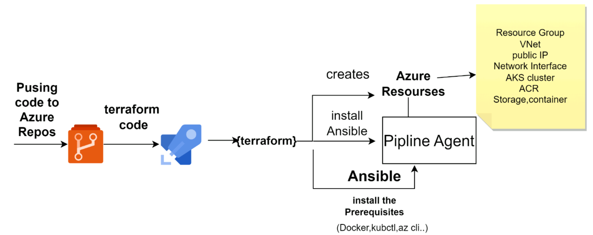
Terraform Pipeline - Agent Setup

Slide 9
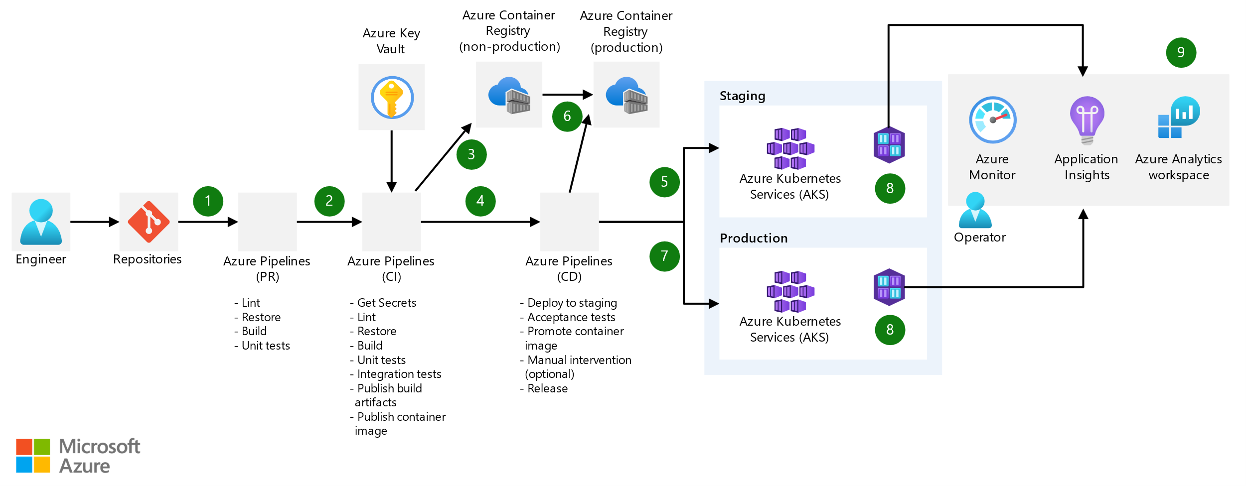
Azure CICD Pipeline

Slide 10
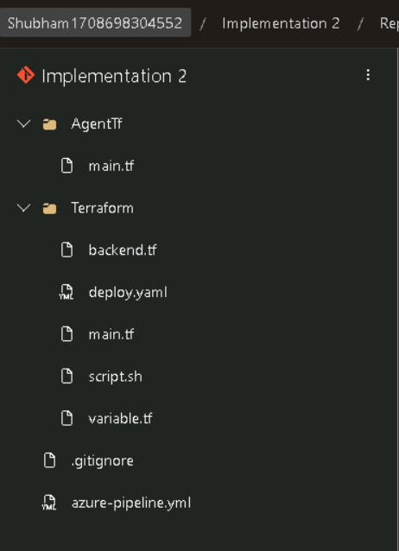
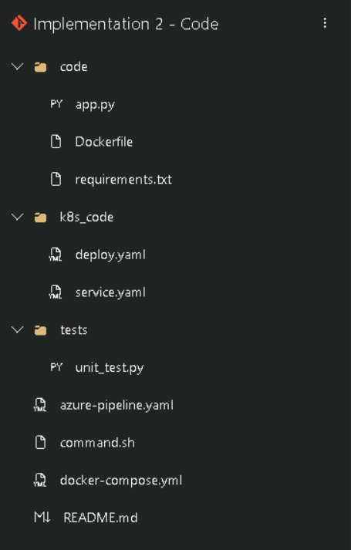
Project Code

Slide 11
Thank you

